Slide 1


SLOVAK BATTERY ALLIANCE
Established 2019

Slide 2

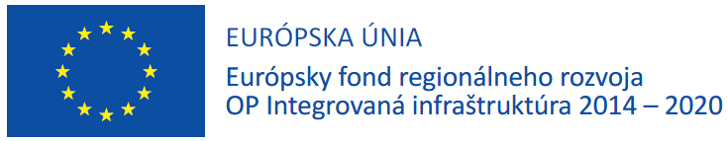



















Slide 3

Slovak battery alliance – 25 members
Founding members:
  Inobat
  IPM
  A.En. Slovensko
  MSM Holding
  GreenWay Infrastructure
  SLOVNAFT
  Matador Holding
  SAV - Centre of Excellence for Advanced Materials Application
  Technical University of Košice
Cooperating entities and new members:
  SNAP Group
  UPJŠ Košice
  University of Žilina
  Slovak University of Technology in Bratislava
  Slovak University of Agriculture in Nitra
  sféra a.s.
  ZSE Energia a.s.
  Slovenské elektrárne – energetické služby
  ZTS Výskum a vývoj
  REACT s.r.o.
  Power Solutions s.r.o.
  PowereX j.s.a.
  MTS spol s.r.o.
  AgeVolt Slovakia, s.r.o.
  Carl Zeiss Slovakia, s.r.o.
  Veolia Energia Slovensko a.s.
Total turnover of SBaA members over 4,1 billion EUR
Over 5100 employees
Leading scientific workforce, all slovak technical universities
SBaA consist of companies with strong industrial background in Slovakia

Slide 4

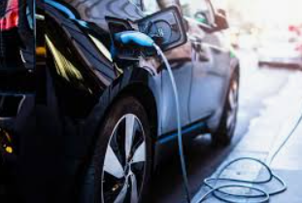
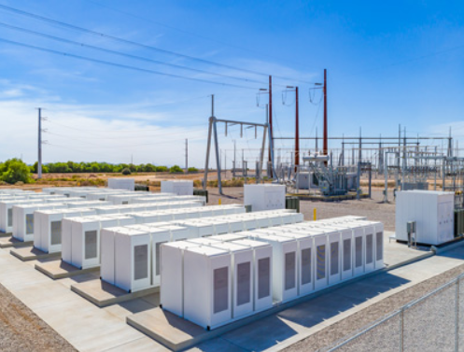
Slovak battery alliance – 3 unique main pillars
  Hydrogen technologies
  Electromobility
  Energy storage

Slide 5

Slovak battery alliance – main targets
Support of:
  slovak battery production
  activities leading to R&D
  battery recycling and second battery life
  education in battery ecosystem
  workshop, conferences, working groups focus on legislation and grands
  international cooperation (EBA, EASE, Flow Batteries Europe)

Slide 6
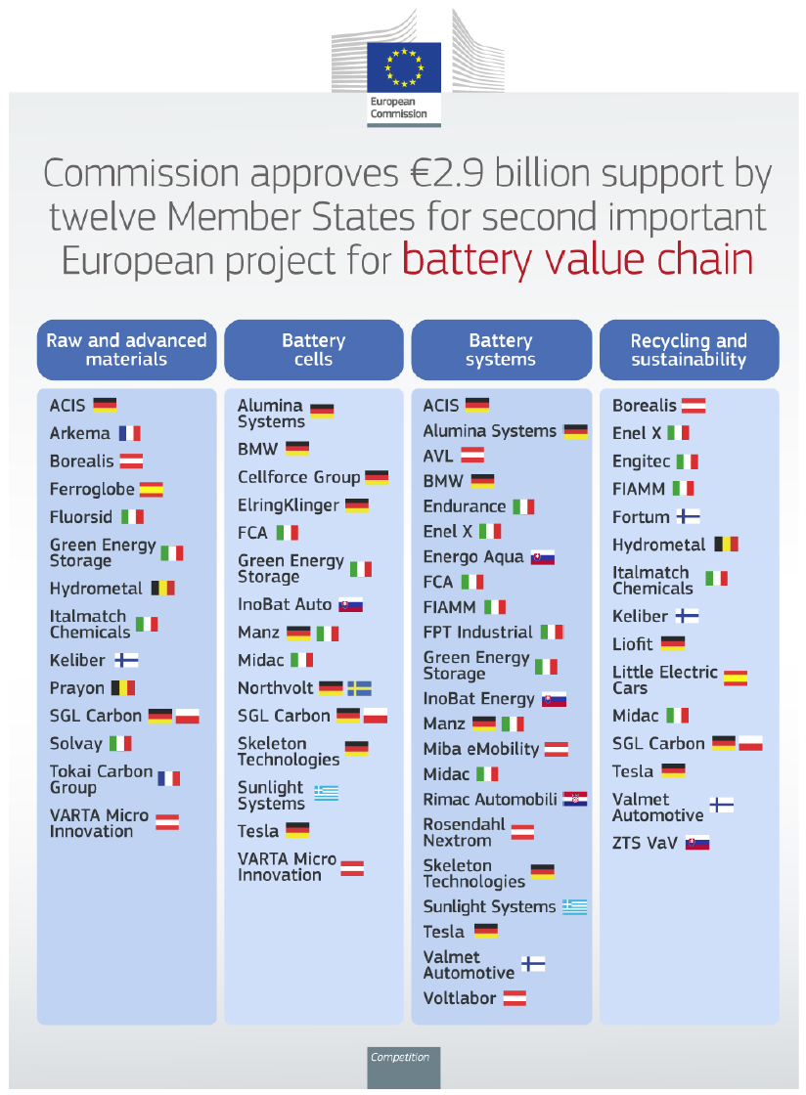

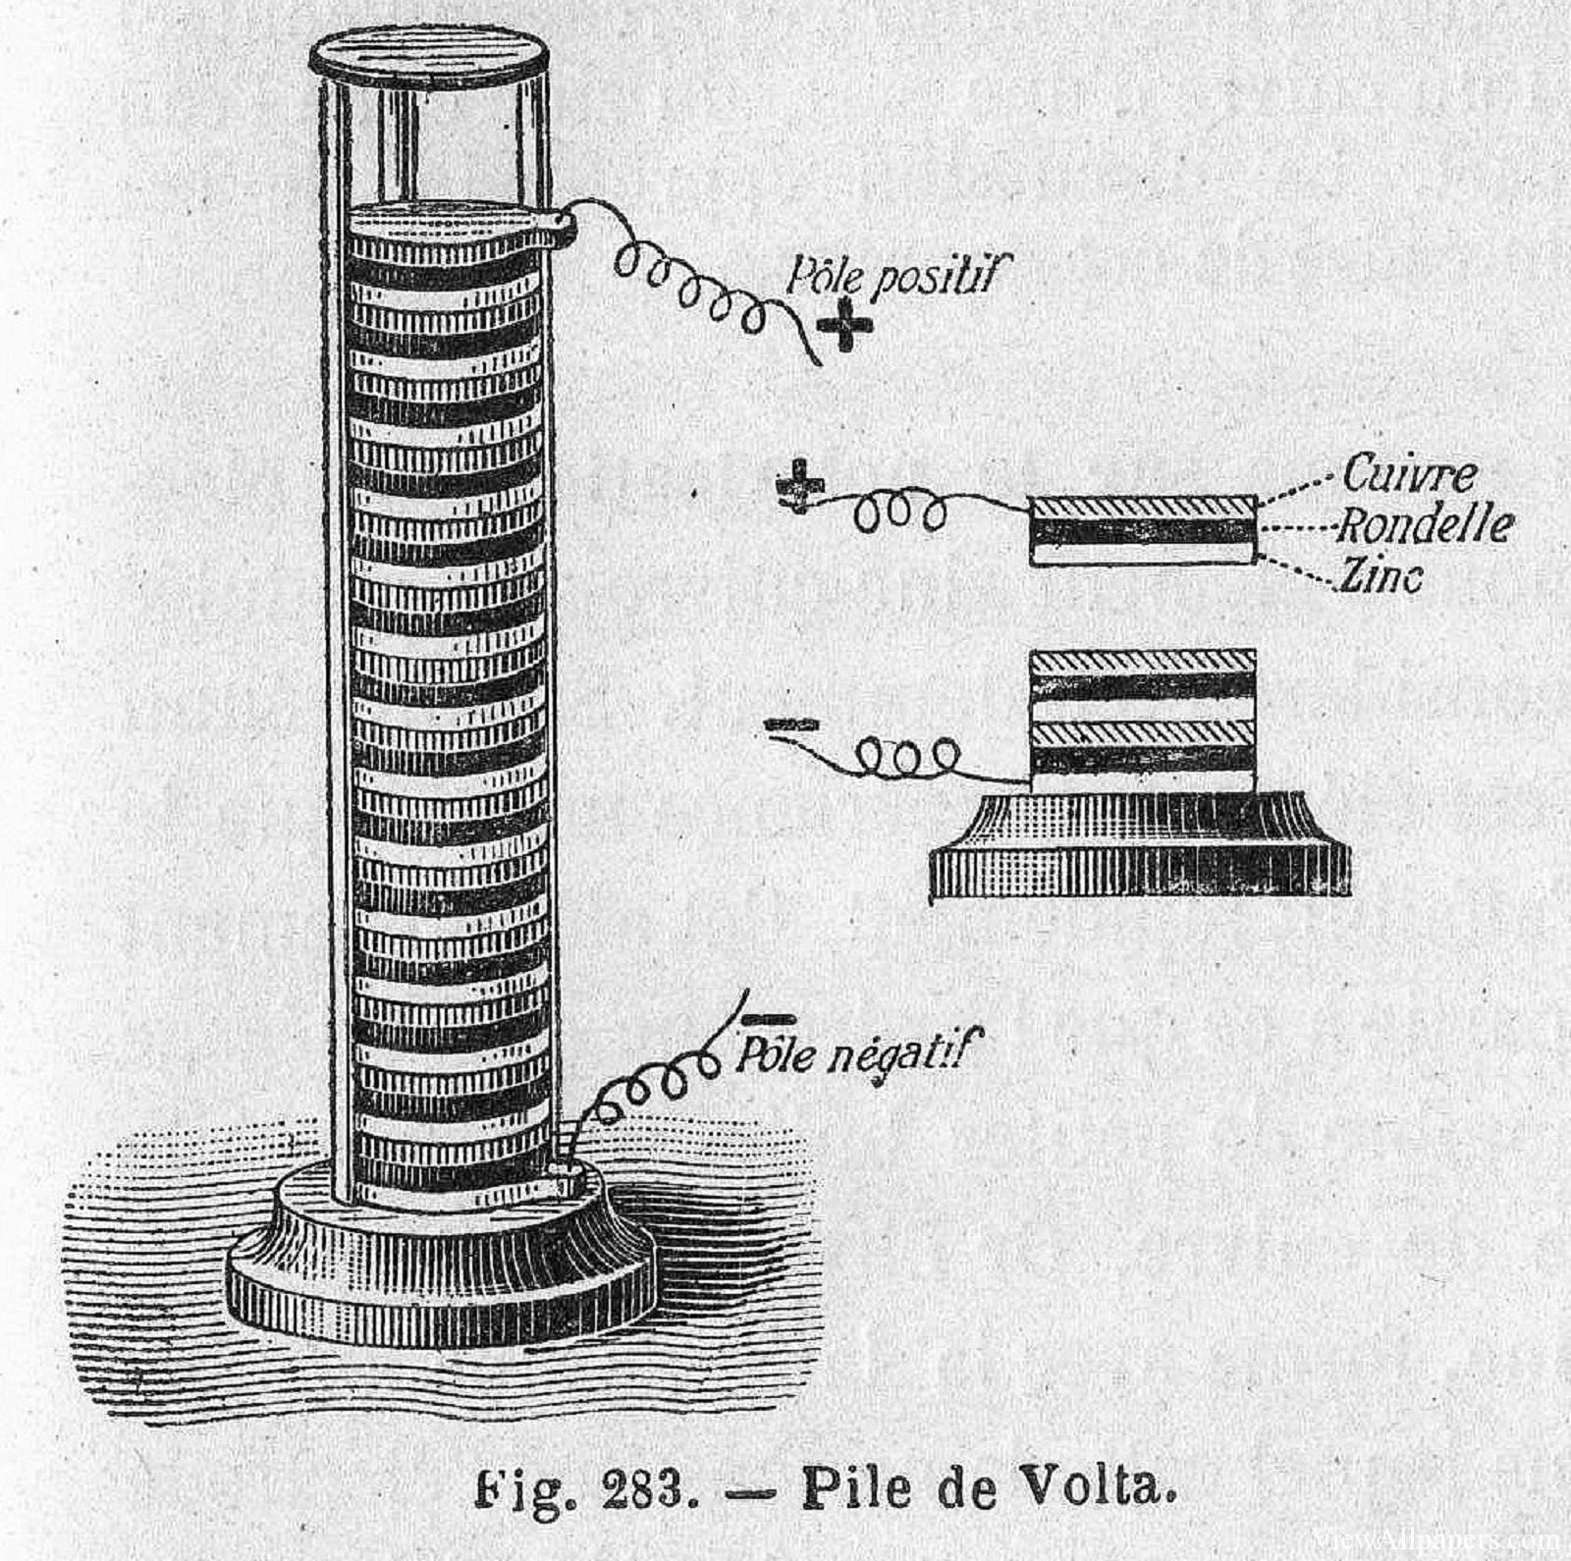
Inovation in Slovakia – IPCEI, Battery centre, GreenLab and Battery of ideas

Slide 7
Slovak battery alliance – demanding COVID years
2021-2022
Negatives brought by COVID:
  slovak battery alliance stopped all B2B/B2C activities,
  all planned business trips
  STOP for main Energy Manifest Conference and all
  workshops, presentations, personal education activities
  problems with planning the implementation of running
  projects
  changes for all budgets
  homeoffice for all employees, request for new IT technologies
  transition to confcalls as the main communication channel
  restrictions for international cooperation (EBA, EASE, Flow Batteries Europe)

Slide 8
Slovak battery alliance – demanding COVID years
2021-2022
Tools for overcome with positive impact:
  provision of new IT technologies for communication
  website improvement
  optimalization of all budgets and projects
  flexibility for employees of SBaA
  development of new internal regulations
  looking for opportunities how to better inform our members
  launch a regular newsletter
  space for quality conference preparation for 2022
  increased care for SBaA members

Slide 9

Thank you
SBaA
e-mail: sbaa@sbaa.sk
mob.: +421 907 734 251

